Slide 1
Managing Data
Lesson 1 Fangzhe Ning

Slide 2
File Organisation & Version Control
Learning Objectives:
Organise digital files using folder hierarchies
Apply proper naming conventions for files and folders
Understand the concept of version control
Describe the purpose of Git and how it supports teamwork

Slide 3

What is File Organisation?
File organisation is the method of arranging digital files and folders in a logical, structured way to make them easy to locate, access, and manage.
Keeps your projects clean and manageable
Makes files easier to find
Prevents duplication or misplaced documents

Slide 4
Naming Conventions
Naming conventions are a set of agreed rules or guidelines used to create clear, consistent, and meaningful file and folder names.
Identify a file’s purpose, version, or date
Avoid confusion or duplication
Improve file search and organisation across teams
Best practices:
Use lowercase letters and underscores or hyphens
Include key info: purpose, version, and date
Use ISO date format: YYYY-MM-DD

Slide 5
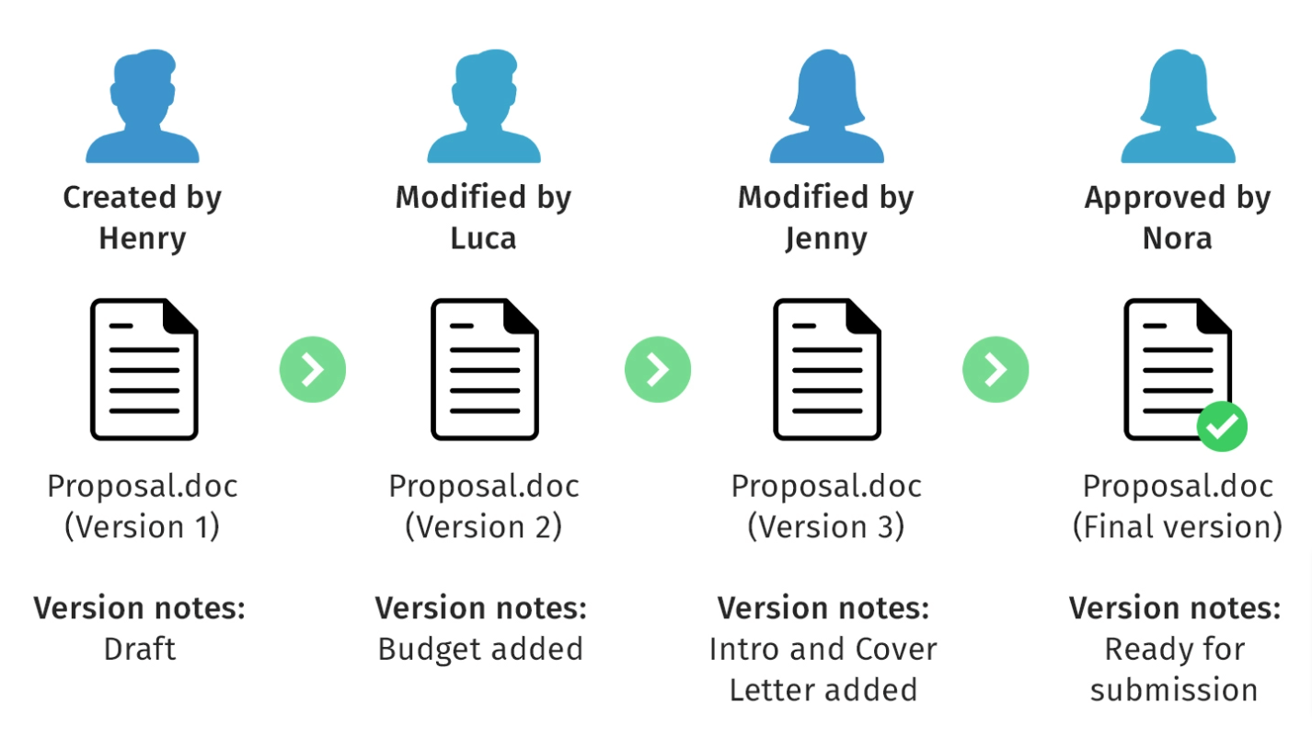
What is Version Control?
Version control is a system that records every change made to a file.
Why do we use it?
Tracks changes
Restores old versions
Prevents overwriting others’ work

Slide 6

What is Git?
Git is a distributed version control system used to track changes in files and coordinate work among multiple people.
Why do we use it?
Save snapshots of your work (commits)
Roll back to earlier versions
See who changed what and when
Merge changes from multiple team members
Git is one of the most widely used version control tools in software development and digital projects.

Slide 7
Why Teams Use Git
Note: Git = Version control tool
GitHub = Cloud platform for team projects
Without Git:
File conflicts are common: Team members may accidentally overwrite each other’s work when editing the same file.
Version confusion: Multiple versions of the same file make it difficult to identify the latest or correct version.
No rollback option: Once a mistake is saved, it's hard or impossible to recover a previous version without backups.
Poor accountability: You can't track who made specific changes, or when and why they were made.
With Git:
Isolated development: Each team member works on their own branch or copy of the project, reducing the risk of conflicts.
Controlled merging: Git allows you to combine everyone’s contributions into a single version, resolving conflicts safely and efficiently.
Complete history tracking: Every change is saved with a timestamp, author name, and a descriptive message — providing a transparent record of project development.
Easy rollback: You can revert to any previous version of a file or project if something goes wrong.

